Slide 1



PRESENTED BY
PRIYANKA C (192511074)
P
ROLE OF
NUMBER THEORY
IN CRYPTOGRAPHY:
FROM EUCLID TO EULER

Slide 2
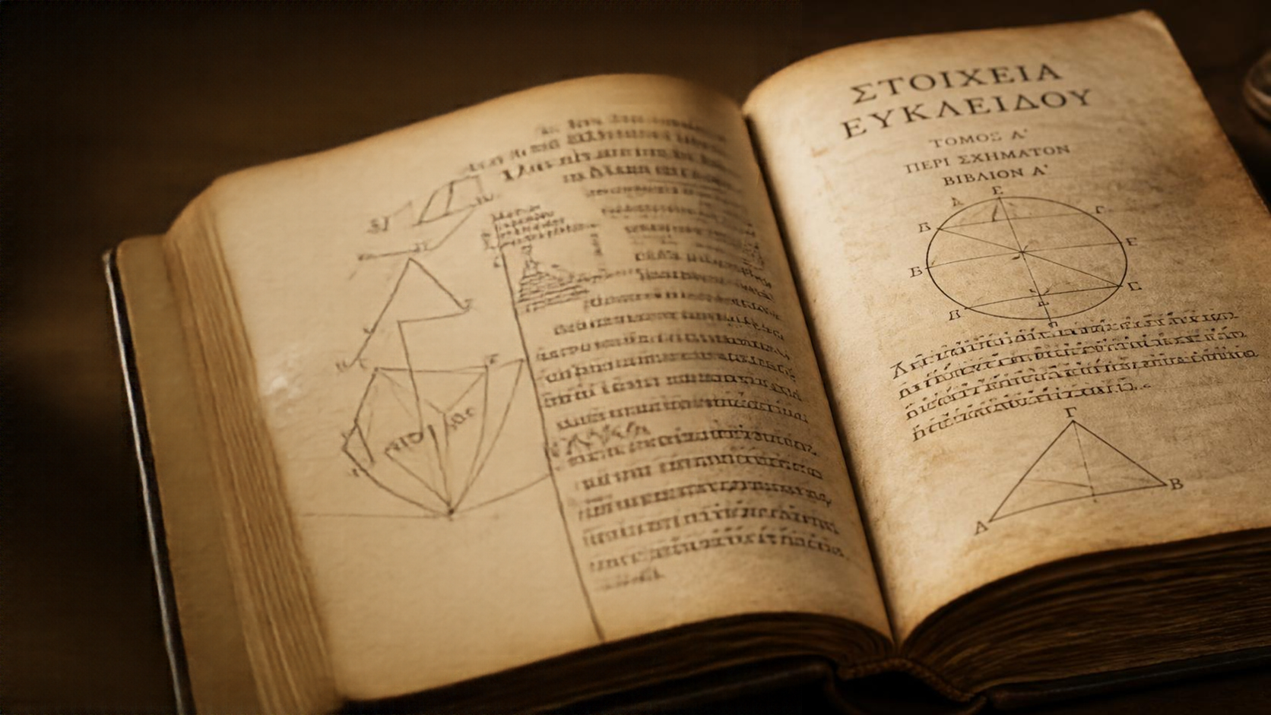


HISTORICAL FOUNDATIONS OF NUMBER THEORY IN CRYPTOGRAPHY
Number theory forms the mathematical backbone of cryptography
Ideas shaped by Euclid and Euler
Centuries of insight securing modern data

Slide 3






EUCLID’S ALGORITHM AND ITS CRYPTOGRAPHIC SIGNIFICANCE
EXAMPLE: FIND GCD(252, 105)
252 = 2 × 105 + 42
remainder 42
105 = 2 × 42 + 21
remainder 21
Euclid’s algorithm efficiently finds the greatest common divisor (GCD).
GCD ensures numbers are coprime,
a foundation of secure keys.
42 = 2 × 21 + 0
remainder 0
It underpins modular inverses and many encryption schemes.
GCD(252, 105) = 21
Simple steps, profound impact on modern cryptography.

Slide 4

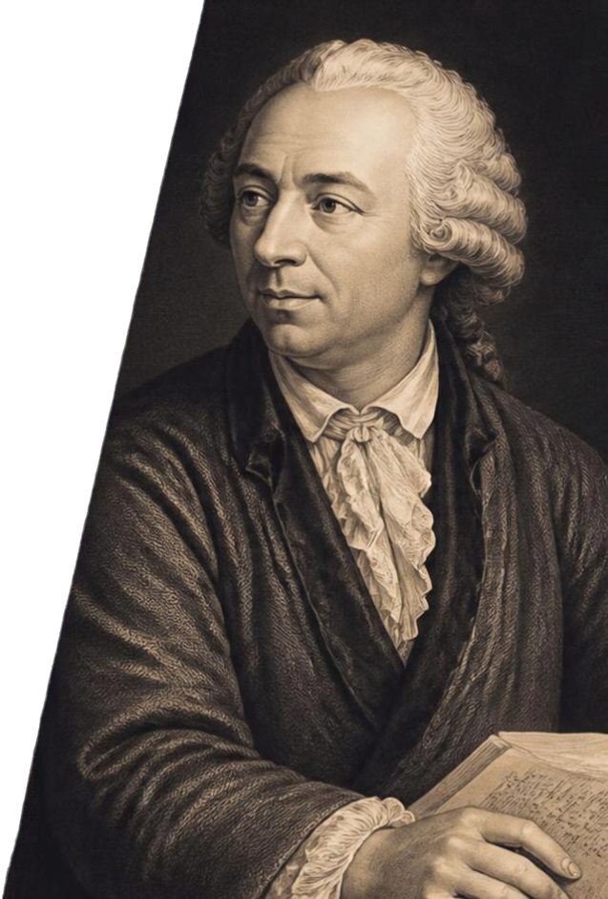

EULER’S TOTIENT FUNCTION AND THEOREM
TOTIENT FUNCTION Φ(N)
EXAMPLE
Counts the integers up to n that are coprime to n.
For n = 9
Numbers coprime to 9: 1, 2, 4, 5, 7, 8
EULER’S THEOREM
So, φ(9) = 6
For coprime a and n,
a^\(n) = 1 (mod n).
Take a = 2
CRYPTOGRAPHIC IMPACT
2^\(9) = 2^\(6 = 64
Foundation for RSA and many other public key cryptosystems.
64 = 1 (mod 9)
Euler’s theorem verified.

Slide 5



FROM THEORY
TO PRACTICE
Number theory powers modern cryptography
KEY CRYPTOGRAPHIC ALGORITHMS
CLASSICAL NUMBER THEORY PROBLEM
CRYPTOGRAPHIC APPLICATION
RSA encryption
and key generation
Factoring large integers
RSA encryption
and key generation
Diffie-Hellman
key exchange
Discrete logarithms in finite fields
Diffie-Hellman
key exchange
EIGamal
encryption
Discrete logarithms for encryption
EIGamal
encryption
Euclid’s algorithms and Euler’s theorems provide the structure that makes secure encryption possible.

Slide 6

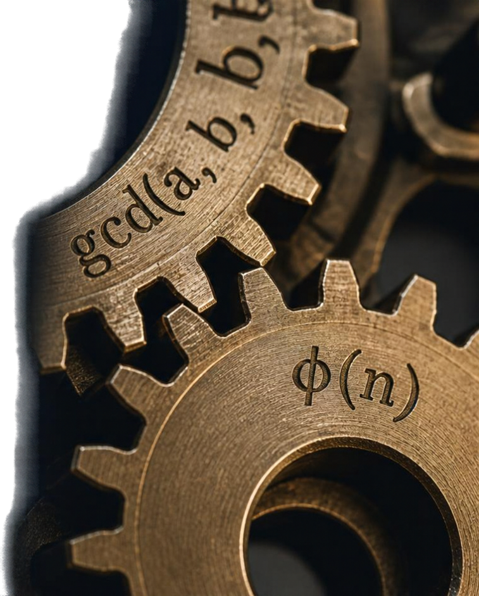
KEY
TAKEAWAYS
Core number theory powers algorithms and digital security
Euler’s totient function enables
public key systems
Centuries of mathematics remain
essential to modern protection
Mastering these ideas drives
cryptographic innovation

Slide 7



THANK YOU
FOR YOUR
ATTENTION
Questions and discussion welcome

